Slide 1


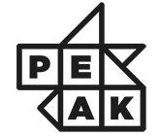


Week 10: Reinforcement Learning

Slide 2
Reference
Reinforcement Learning: An Introduction by Andrew Barto and Richard S. Sutton

Slide 3
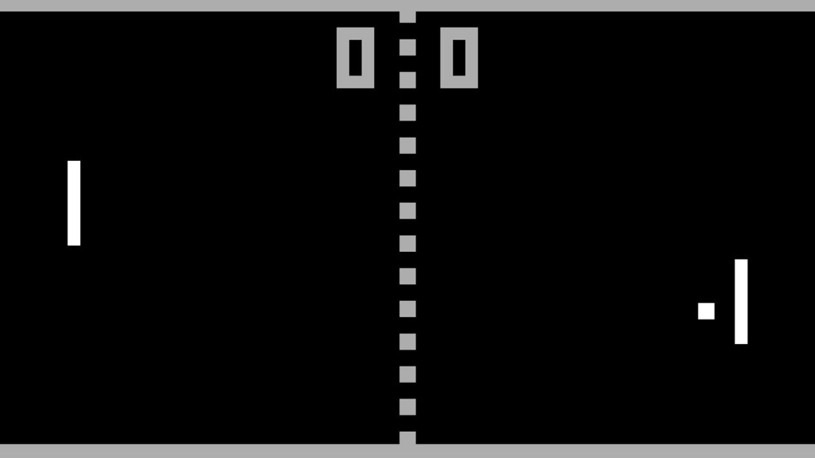
Introduction

Slide 4
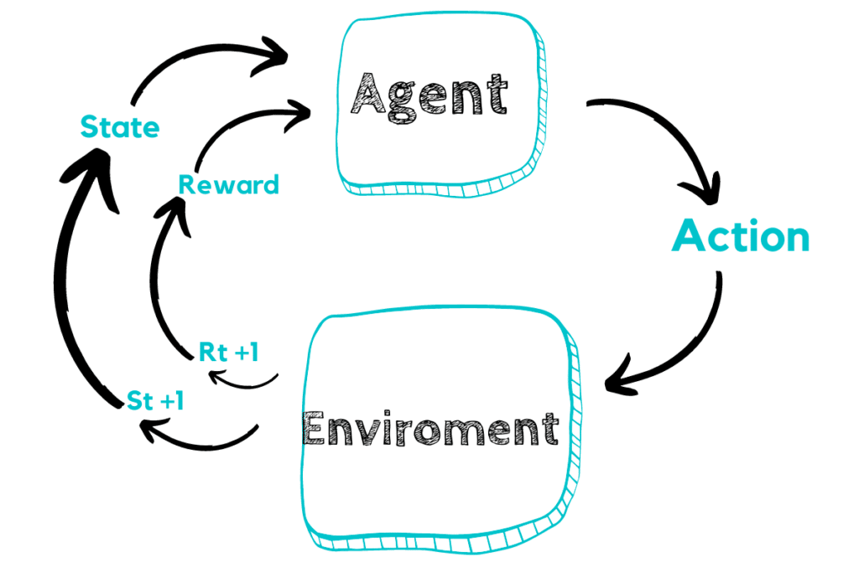
Introduction

Slide 5
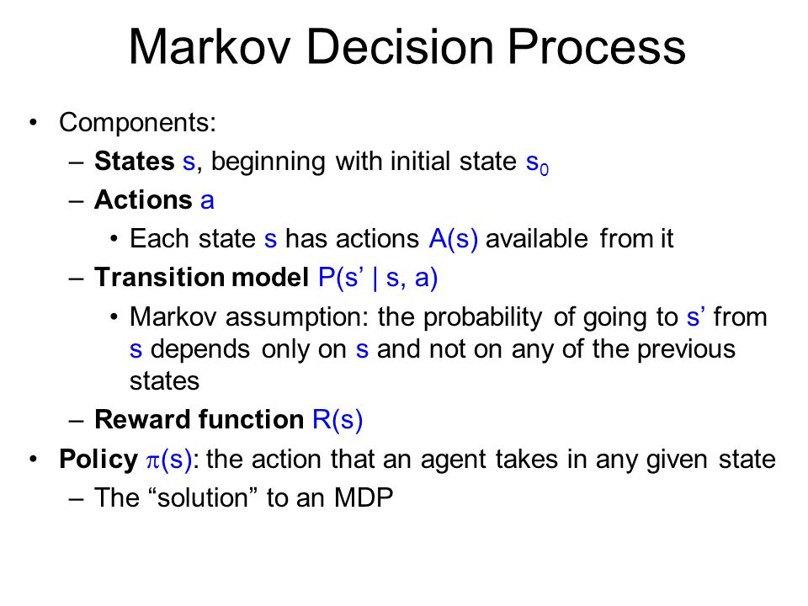
Markov Decision Process

Slide 6

Markov Decision Process
Trajectory:

Slide 7
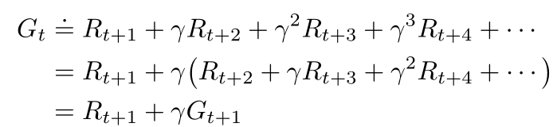
Value functions

Slide 8
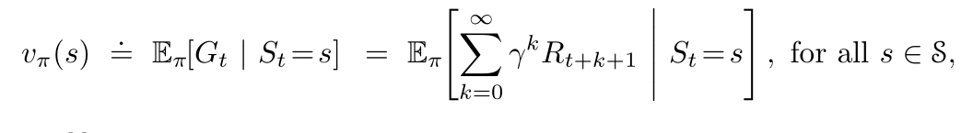
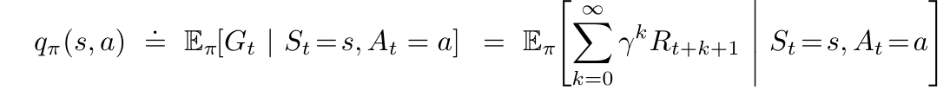
Value functions
State:
Action(quality):

Slide 9
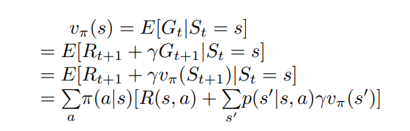
Bellman’s equation

Slide 10
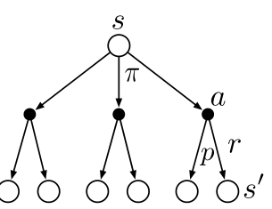
Bellman’s equation

Slide 11
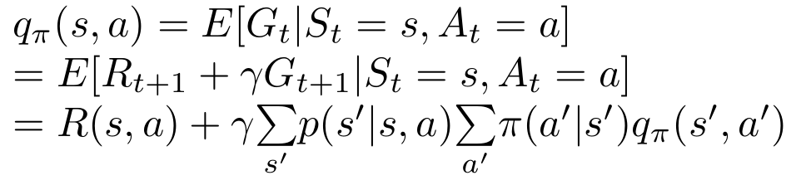
Bellman’s equation

Slide 12
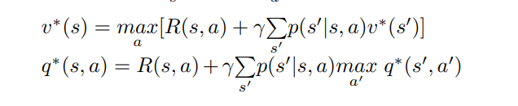
Bellman’s equation

Slide 13
Exploration vs Exploitation
Exploration: Choose non-optimal actions to refine estimate of their values
Exploitation: Select optimal actions based on current estimate (which may be inaccurate)

Slide 14
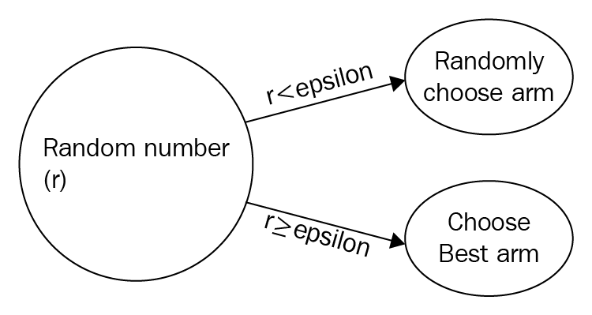
Exploration vs Exploitation
Epsilon Greedy:Probability ε of choosing a random action

Slide 15
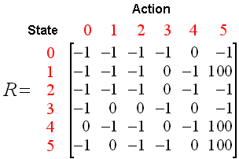
Q Learning:

Slide 16
Q-Learning:

Slide 17
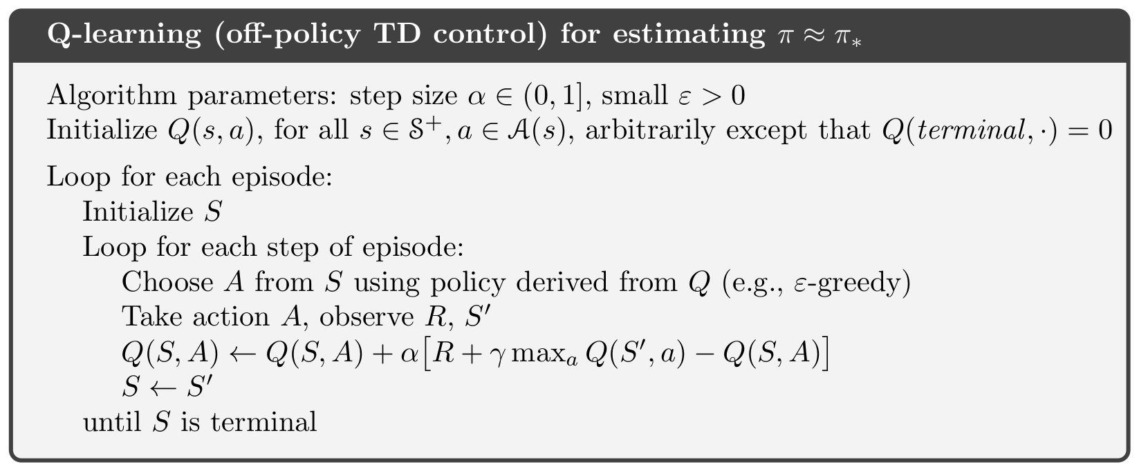
Q-Learning:

Slide 18
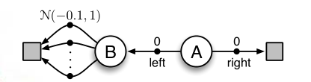
Double Q Learning
Maximization bias:

Slide 19
Double Q Learning
Solution:Have two Q-tables

Slide 20
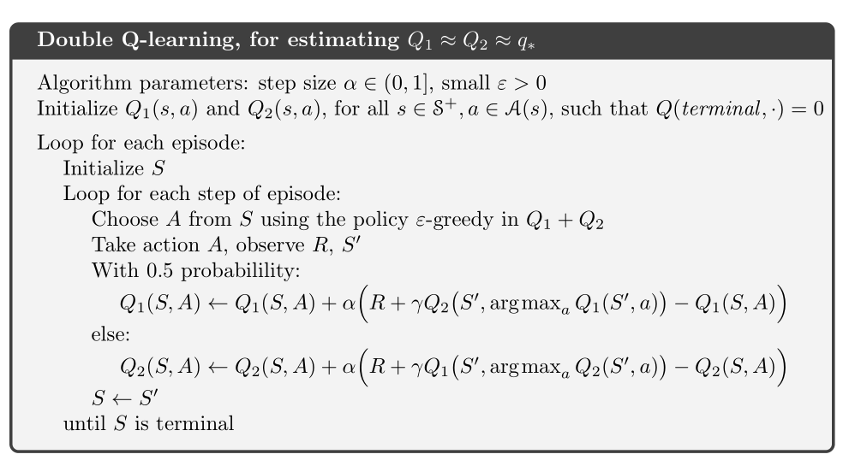
Double Q Learning

Slide 21
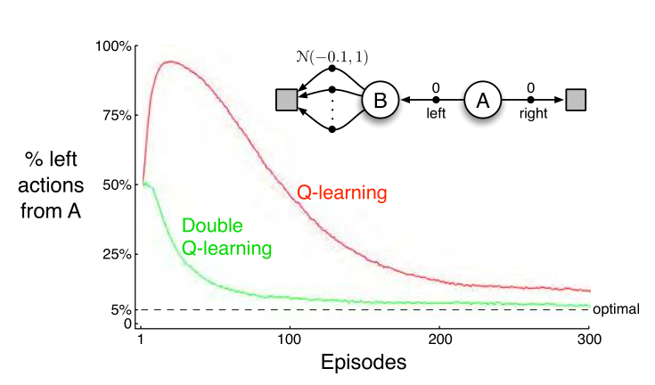
Double Q Learning

Slide 22
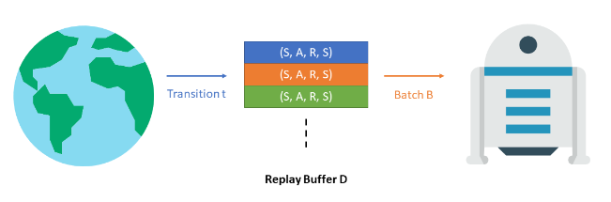
DQN: Deep learning meets reinforcement learning
Use neural networks to approximate q functions
Experience replay:

Slide 23
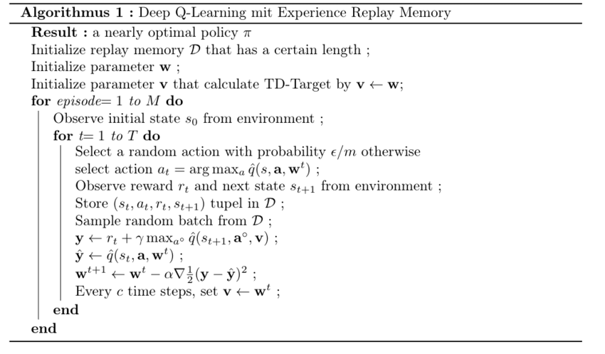
DQN: Deep learning meets reinforcement learning

Slide 24
Policy Gradient:
Policy as a neural network
Softmax for probabilities: Converge to deterministic policy

Slide 25


Policy Gradient:
Objective:
Optimization via gradient ascent:

Slide 26
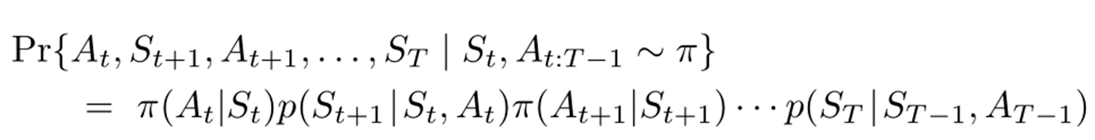
Policy Gradient:
Objective:
Optimization via gradient ascent:

Slide 27
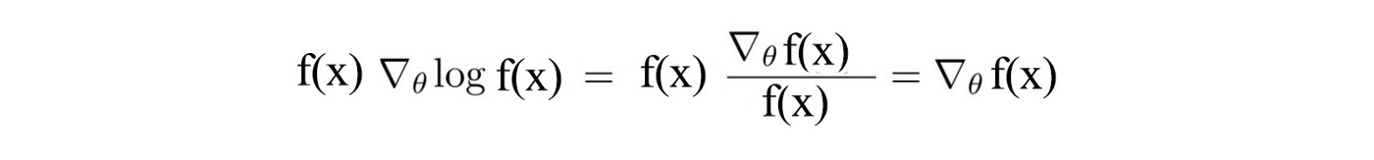

Policy Gradient:
The logarithm Trick:

Slide 28
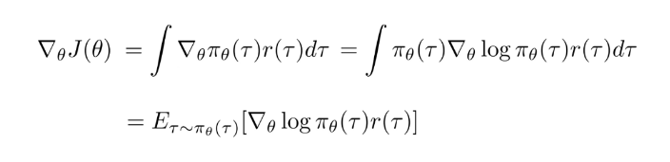
Policy Gradient:

Slide 29



Policy Gradient:

